Slide 1
DIABETES PREDICTION
GROUP 2: Paradise Nxumalo, Gugulethu Mabuza, Thabile Maphanga

Slide 2
Research question
What is the relationship between various medical and demographic factors in relation to the likelihood of developing diabetes?

Slide 3
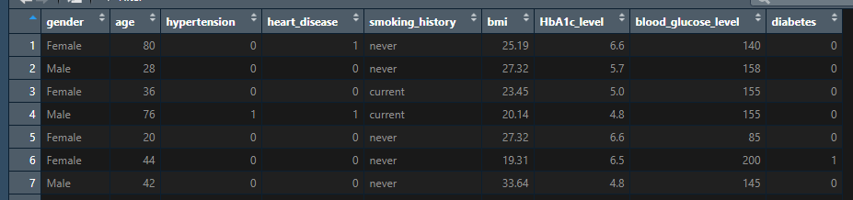
The data
Note:
bmi(Body Mass Index)- a measure of body fat based on weight and height. Higher BMI values are linked to a higher risk of diabetes. The range of BMI in the dataset is from 10.16 to 71.55. BMI less than 18.5 is underweight, 18.5-24.9 is normal, 25-29.9 is overweight, and 30 or more is obese.
HbA1c _level(Hemoglobin A1c) level -a measure of a person's average blood sugar level over the past 2-3 months. Higher levels indicate a greater risk of developing diabetes. Mostly more than 6.5% of HbA1c Level indicates diabetes
Data source: https://www.kaggle.com/datasets/iammustafatz/diabetes-prediction-dataset
Notes:
Gender :Gender refers to the biological sex of the individual, which can have an impact on their susceptibility to diabetes.
Age: Age is an important factor as diabetes is more commonly diagnosed in older adults. Age ranges from 0-80 in our dataset.
Hypertension: hypertension is a medical condition in which the blood pressure in the arteries is persistently elevated. It has values a 0 or 1 where 0 indicates they don’t have hypertension and for 1 it means they have hypertension.
Heart disease: heart disease is another medical condition that is associated with an increased risk of developing diabetes. It has values a 0 or 1 where 0 indicates they don’t have heart disease and for 1 it means they have heart disease.
Smoking history is also considered a risk factor for diabetes and can exacerbate the complications associated with diabetes. In our dataset we have 5 categories i.e not current,former,No Info,current,never and ever.
BMI(Body Mass Index) is a measure of body fat based on weight and height. Higher BMI values are linked to a higher risk of diabetes. The range of BMI in the dataset is from 10.16 to 71.55. BMI less than 18.5 is underweight, 18.5-24.9 is normal, 25-29.9 is overweight, and 30 or more is obese.
HbA1c _level: HbA1c(Hemoglobin A1c) level is a measure of a person's average blood sugar level over the past 2-3 months. Higher levels indicate a greater risk of developing diabetes. Mostly more than 6.5% of HbA1c Level indicates diabetes
Blood glucose level refers to the amount of glucose in the bloodstream at a given time. High blood glucose levels are a key indicator of diabetes.
Diabetes is the target variable being predicted, with values of 1 indicating the presence of diabetes and 0 indicating the absence of diabetes.

Slide 4
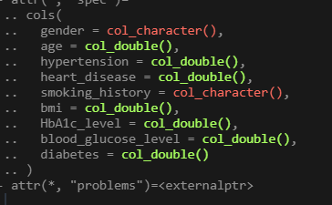
The data
Stripping the data allows us to see that the gender and smoking history columns are characters, which may beg the question, how many levels are there?
Do we need to do some cleaning?

Slide 5
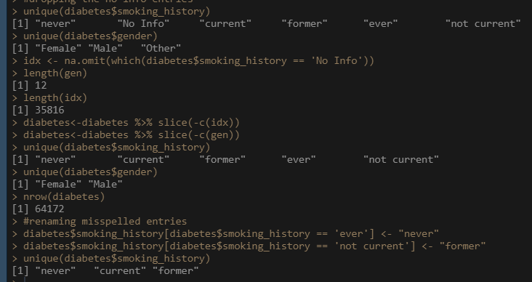
Cleaning the data
Smoking history: we have ‘No Info’ which is a null entry and “former” alongside “not current” pretty much mean the same thing so we may one to combine those
Gender: Some entries identify as other.
Result: the final look of our data contains only the two common genders. We removed “other”, it had only 12/100 000 entries thus not very significant. We removed the “No Info” entries resulting in 35 816 less entries

Slide 6
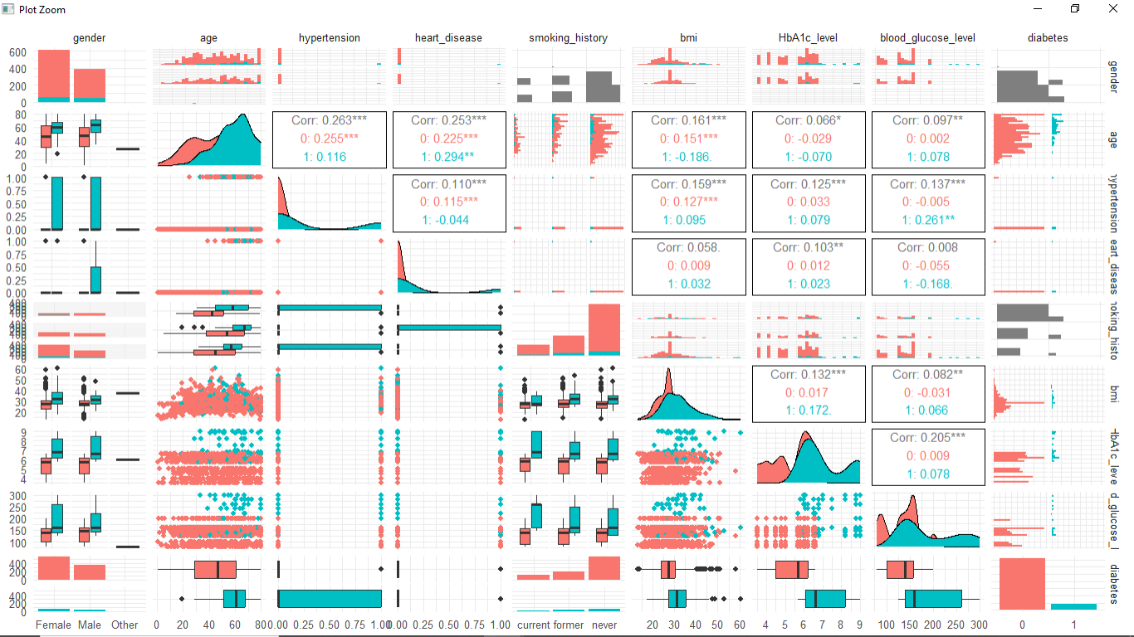
visualization
Notes:
Red: with diabetes
Blue: without
More without than with, proportion of men with is more than females with diabetes.
A lot of those with high glucose level have diabetes. Most of those with low glucose level do not have.

Slide 7
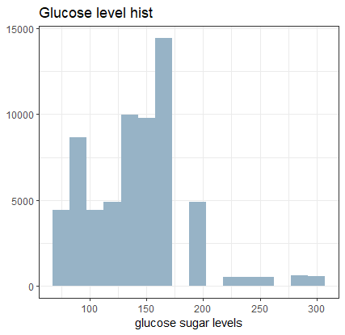
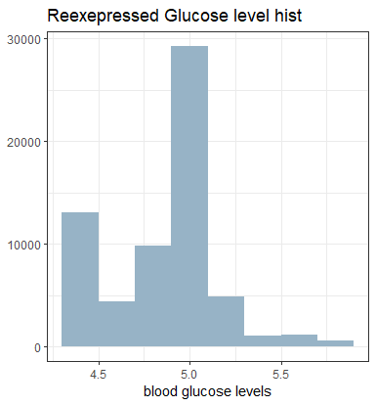
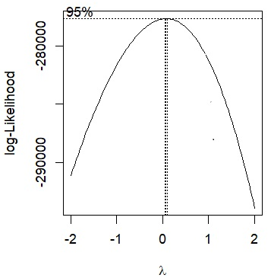
Glucose sugar level
The raw display an abnormal distribution looking somewhat right skew making it impossible to work with. Its box-cox transformation suggests a log re-expression. The new histogram is not perfect but it has improved from its raw distribution.

Slide 8
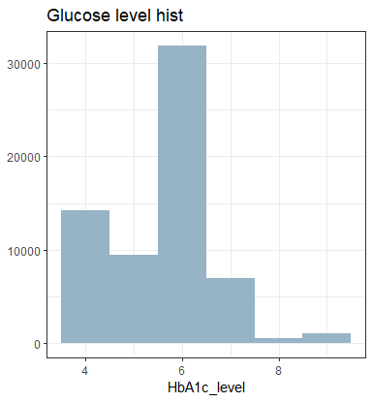
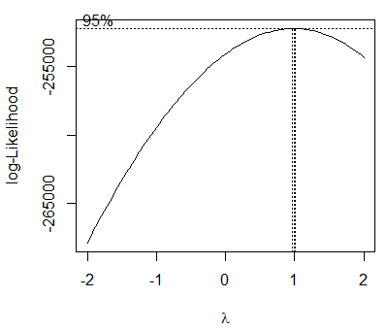
HbA1c _level
According to the box-cox transformation, the HBA1C_Level has a perfect distribution.

Slide 9
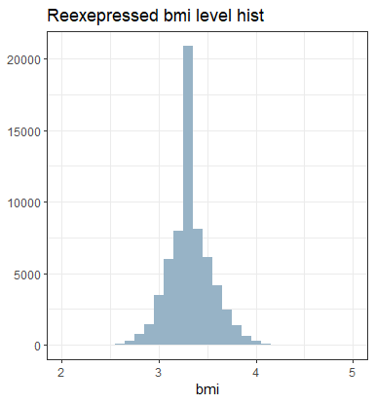
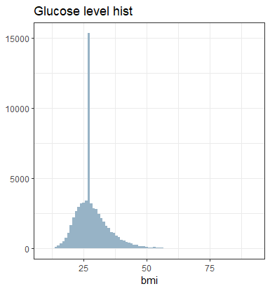
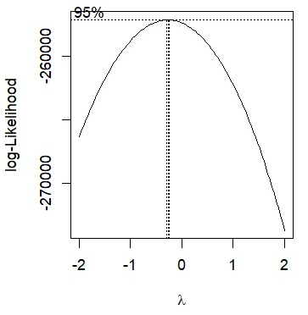
Body mass index(bmi)
The bmi’s distribution could clearly do with some improvement. Looking at its box-cox transformation, a log re-expression best. Looking at its transformed histogram, there is a visible improvement. It certainly looks more normal even though the middle appears too tall, possibly due to some outlying points

Slide 10
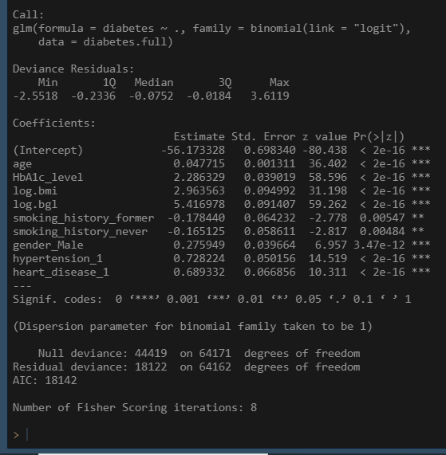
Full logistic model
From our model, we learn that indeed most of the regressors are significant in influencing whether or not an individual develops diabetes. The most significant factor clearly being the blood glucose level with an estimated coefficient of 5.42. Least significant factor is the smoking history

Slide 11
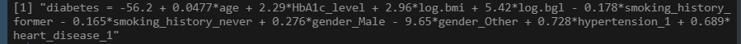
Full logistic equation
Our model tells us that we should expect to see the age increase by 0.0477 per unit when all the others repressors are kept constant. The HbA1c level will increase by 2.29 per unit when all the others regressors are kept constant. The log.bmi will also increase by 2.96 per unit when all the others regressors are kept constant and the log.bgl will rise by 5.42 per unit when all the others regressors are kept constant. The smoking
-history_former decrease by 0.178 per unit when all the others regressors are kept constant…

Slide 12
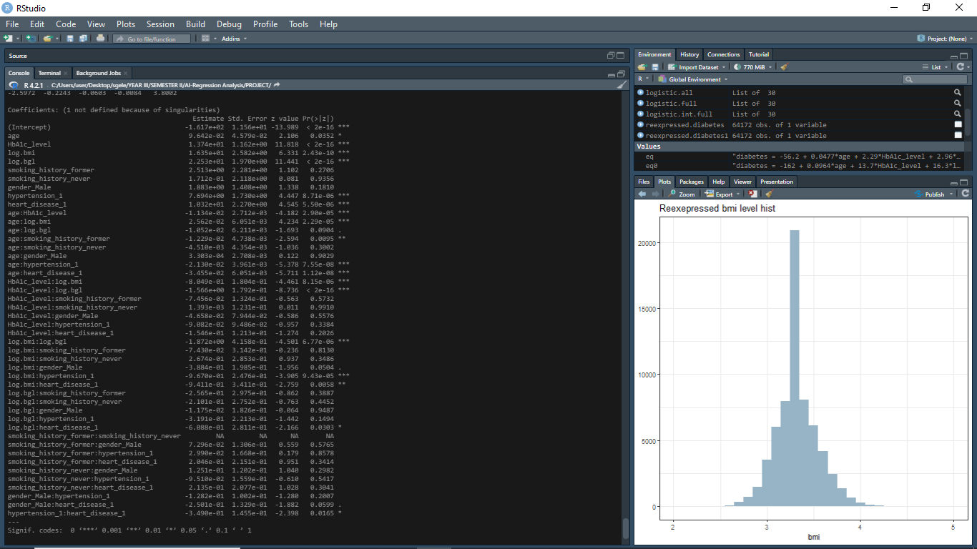
Full interactive model
age:HbA1c_level is significant (P-value is 2.9^-05) .Significant difference between the slopes of the lines for HbA1c_ level at different ages & whether or not they have diabetes.
age:smoking_history_never is not significant(p-value is 0.3002). There is no significant difference between the slopes of lines for never smoked at different ages and whether or not they have diabetes.

Slide 13
Full interactive model cont..
log.bmi:hypertension1 is certainly significant (p-value is 9.43^-05). Significant difference between the slopes of the lines for a person with hypertension at different measures of the body mass index & whether or not they have diabetes.
smoking_history_former:gender_Male is not significant(p-value is 0.58). There is no significant difference between the lines for a male at different measures of their smoking history and whether or not they have diabetes.

Slide 14
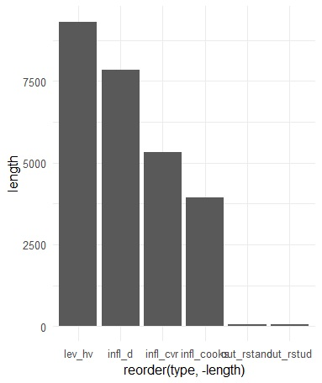
Outlier analysis
Our outliers analysis shows that we have a lot of leverage points but they do not disturb the study so much. We have very few outliers. Looking at the influential points, infl_cooks has an proportionally average number of influential points and not too many making it the best one to remove from our data. Hopefully, removing these will improve our model without making the data inaccurate.

Slide 15
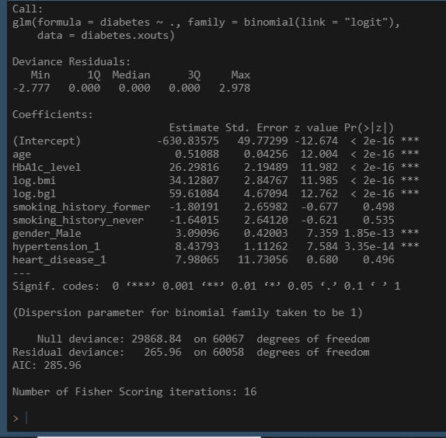
Logistic without outliers
Building a model without the outliers persists with asserting that the smoking history along with having heart disease are not significant in determining whether a person develops diabetes. On the other hand, the age plays a role is the prevalence of diabetes, the HbA1c_level as well as the bmi along with the blood glucose level, the male gender and having hypertension are all significant.

Slide 16
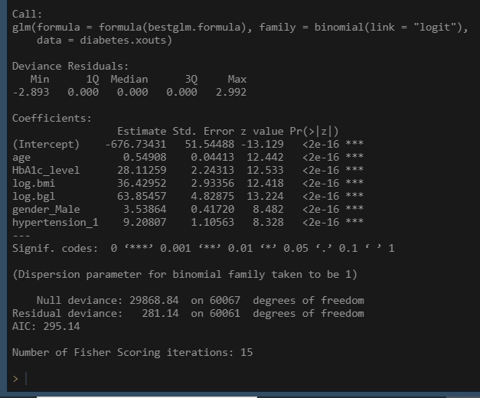
Best glm
The bestglm model has successfully removed the insignificant regressors. This leaves behind only the age,HbA1c_level,bmi,blood glucose level,gender_Male and hypertention. The most significant regressor is definitely the blood glucose level with an estimated coefficient of 63.85. the 2nd most significant is the body mass index with a coefficient of 36.42. even though age is a significant regressor as well, it is the least significant among these with a coefficient of 0.55

Slide 17
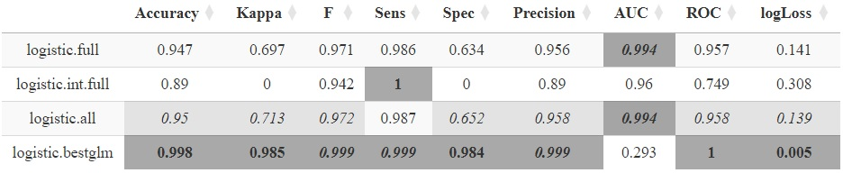
Model evaluation
The best model is clearly the logistic.bestglm. It has the best combination is evaluation measures with its accuracy at 99.8%,kappa at 98.5%. Our F-statistic, Sensitivity and Precision is at 99.9%,Specificity is at 98.4.Surprisingly its AUC is at a disappointing 29.3 %.the ROC is at a perfect 100% with the logLoss at 0.005.

Slide 18
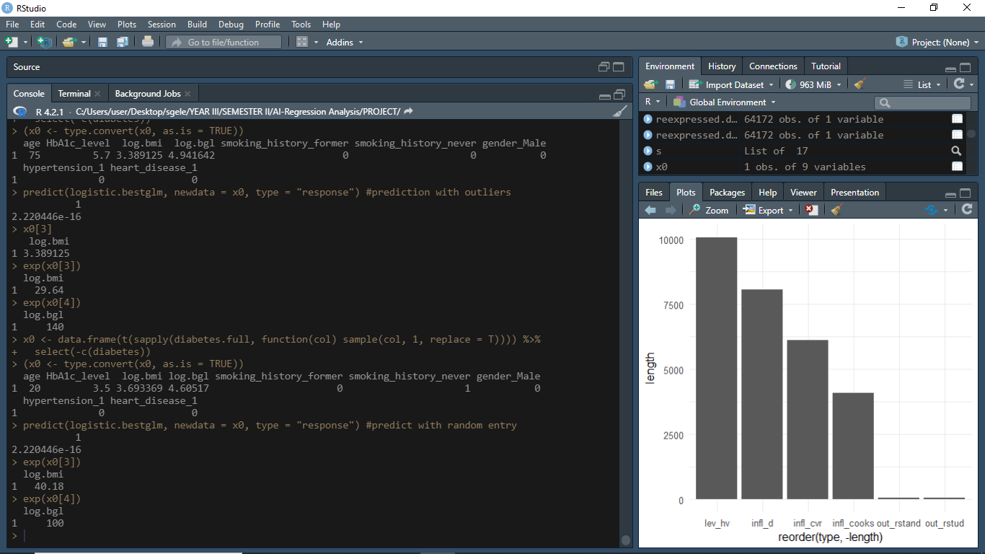
Prediction with outlier
Here we have an individual that is 75 years old, has a hemoglobin level of 5.7 which is close to 6.5 after which diabetes is more likely. This person has bmi of 29 which is overweight, currently smoking, a female with no hypertension nor heart disease. With so many risk factors we would expect this lady to stand higher chances of having diabetes but our model predict they do not have diabetes.

Slide 19
Interpreting the odds ratio
*For every unit increase in age the odds of getting diabetes increases multiplicatively by 1.331226 times when the other predictors remain constant
*For every unit increase in HbA1c_level the odds of getting diabetes increases multiplicatively by 1338861 times when the other predictors remain constant
*For every unit increase bmi the odds of getting diabetes increases multiplicatively by 103231025 times when the other predictors remain constant
*For every unit increase in blood glucose level the odds of getting diabetes increases multiplicatively by 2.119836e+14 times when the other predictors remain constant

Slide 20
Prediction with normal entry
This time we have an individual that is 20 years old, has a hemoglobin level of 3.5 which is quite safe. This person has bmi of 40 which is obese, they have never smoked. They have a blood glucose level of 100 and this is a female with no hypertension nor heart disease. Even though this young lady is obese, she is still looking safe in most of the risk factors and we would expect her to not currently have diabetes and our model correctly predicts so.

Slide 21
conclusion
Looking at the given factors, the blood glucose level has the most significant effect on the prevalence of diabetes with age as the least significant factor. It is remarkable to learn that the smoking history of an individual has no influence on whether on not they develop diabetes. In summation, as a person grows older, the more chances they stand of developing diabetes and more males are diabetic than females

